Slide 1
Environment Setup & Release
New Application
Marquis Hu, 7/10/2019

Slide 2
(Environment Setup)

Slide 3
CER Request
-Budgeted New Project
-Unbudgeted New Project
VMware Request
-Non PROD
-PROD
-LINUXSUPP

Slide 4
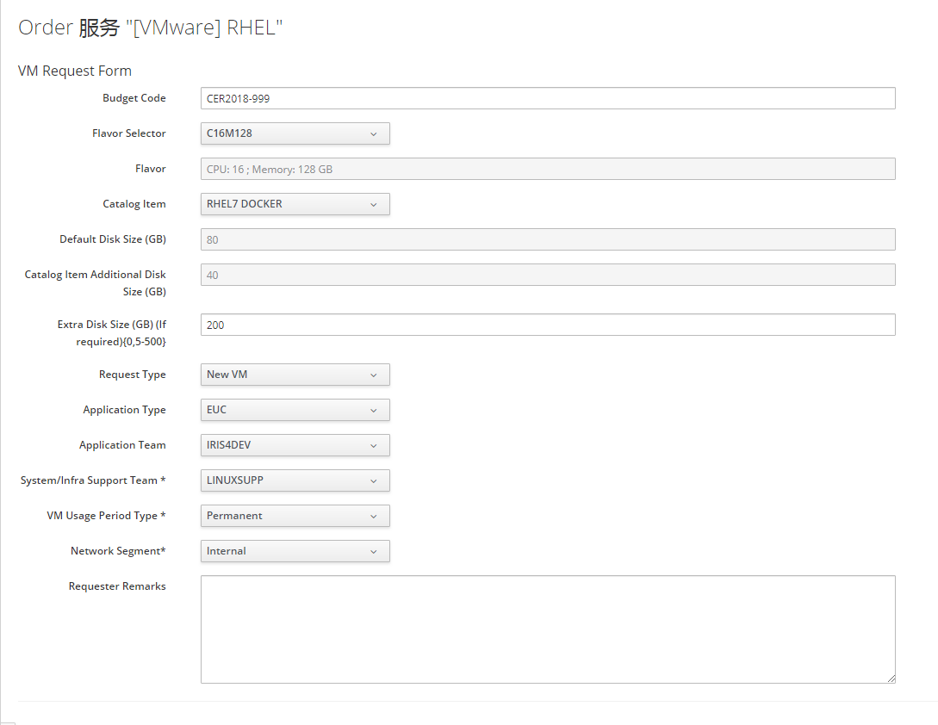
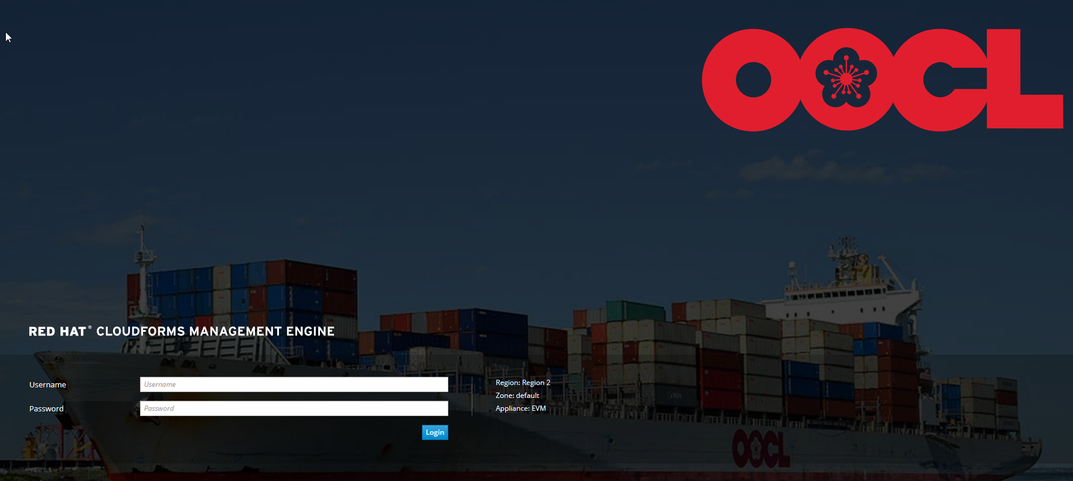
VMware Request

Slide 5
Oracle DB setup
-Oracle Setup Questionnaire
-DB Hostname, Env & SID
-eWallet and AMP placeholder
-Cutover Framework
-OEM
-ORASUPP
CER Request
-Budgeted New Project
-Unbudgeted New Project
VMware Request
-Non PROD
-PROD
-LINUXSUPP
Architecture review
-InfraApp

Slide 6
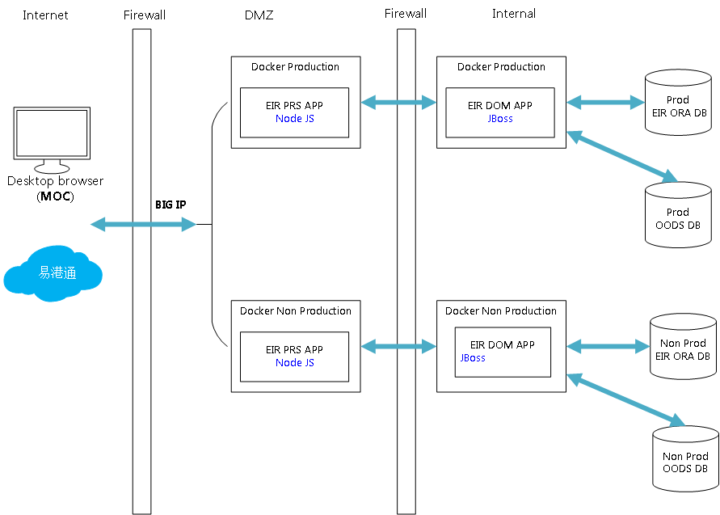
Project Architecture review

Slide 7
Docker & iView
-Project name
-Docker type
-iView permission control
-Entry point
-App & db server
-Production CA SSL cert
-External DNS
-MIPS
Oracle DB setup
-Oracle Setup Questionnaire
-DB Hostname, Env & SID
-eWallet and AMP placeholder
-Cutover Framework
-OEM
-ORASUPP
Firewall Ruleset
-DMZ Server
-Internal Server
-From internet to bigip 443 port
-NSC
CER Request
-Budgeted New Project
-Unbudgeted New Project
VMware Request
-Non PROD
-PROD
-LINUXSUPP
Architecture review
-InfraApp

Slide 8
Create TT Category
-Supporting Document
-Security Assessment Form
-Share it to CMSSUPP
-HKCTR
GIT Repo
-GIT Repositories Creation
Request Form
-GITADMIN
GIT SSH Key
-Create GIT SSH Key
-Submit it to GIT SSH Key
Registration page
CMS setup
-Deploy Permission
-CMSSUPP
PP Deployment
-Setup Web Application Firewall
-Operational Acceptance Test
Submit PCRS
Rollout

Slide 9
(Release)

Slide 10
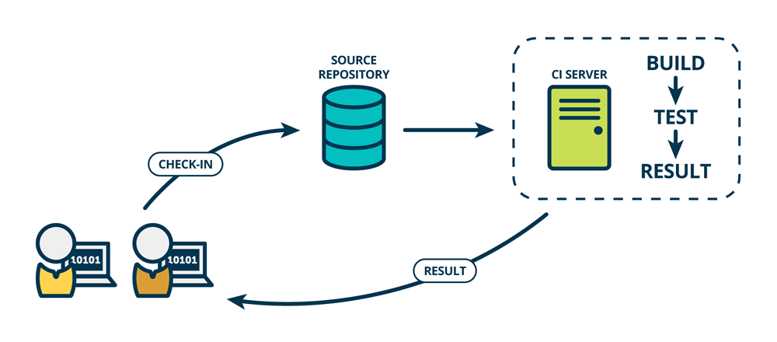
Continuous Integration

Slide 11



CI SERVER
CI SERVER
Gitlab
Fork Repo
Gitlab
Origin Repo
HKGGIT
Repo
PUSH
MERGE
INTEGRATOR
PULL

Slide 12
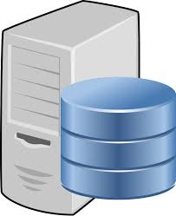
DEV/QA/UAT
HKGGIT
Repo
PACKAGE
DEV/QA/UAT
CMS SERVER
UPLOAD
PULL
DEPLOY

Slide 13
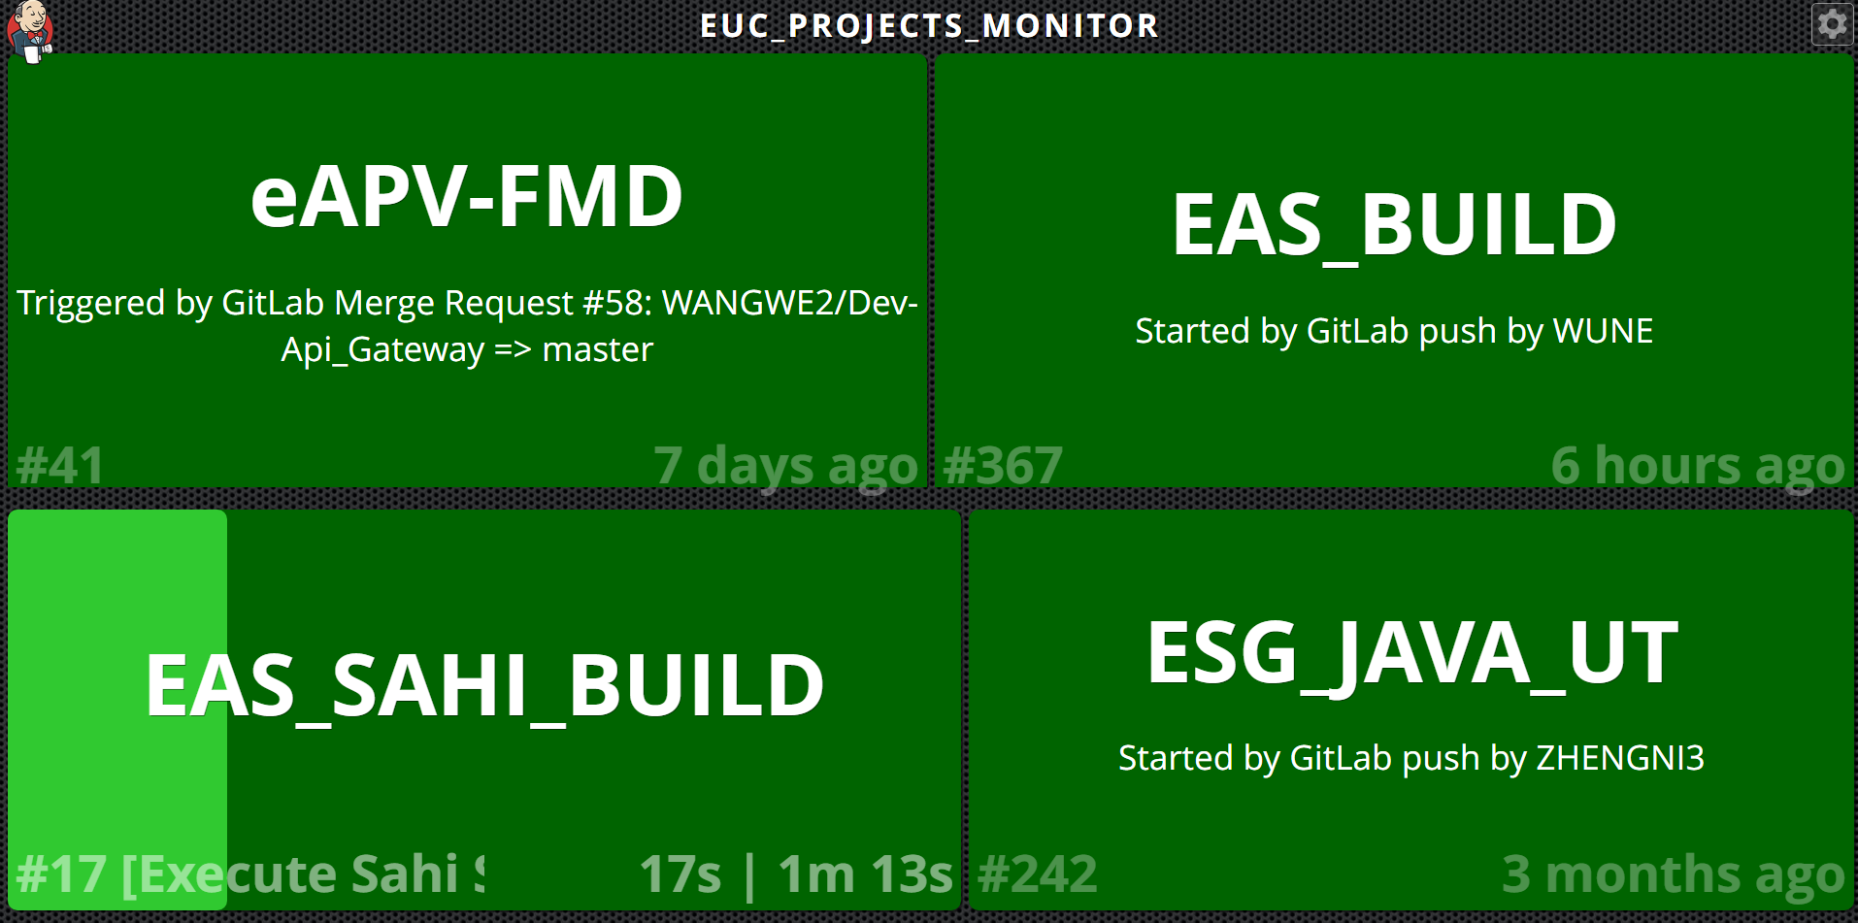

Slide 14
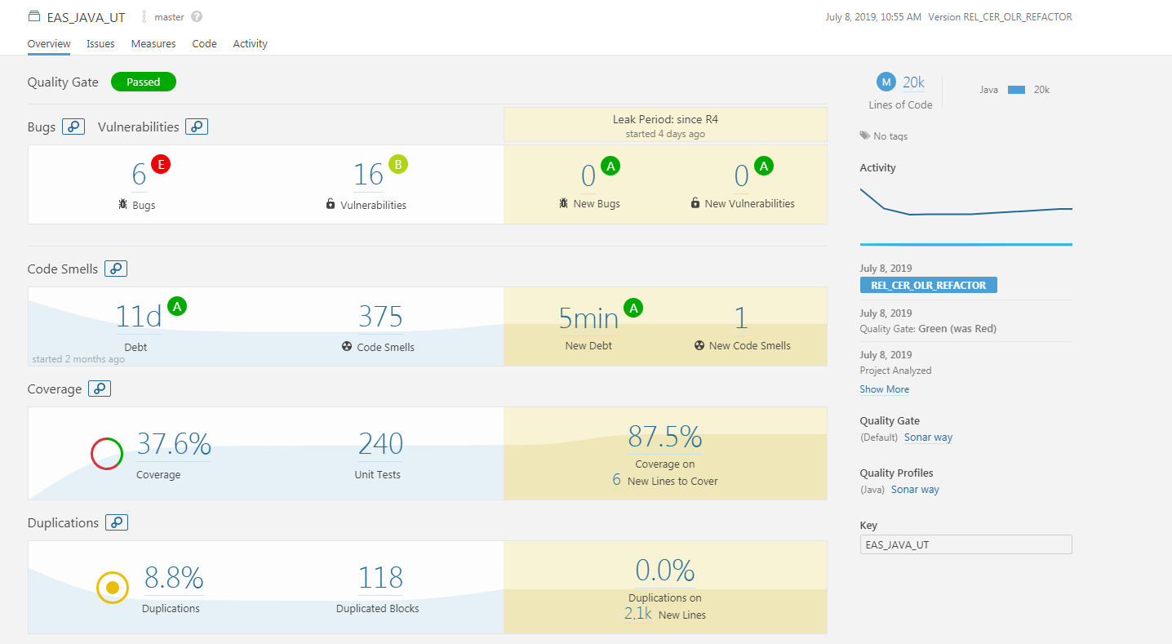

Slide 15


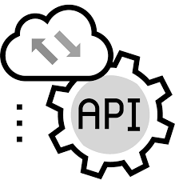

Testing Pyramid
coverage
?
Manual on E2E
50%
Sahi on UI
0%
Integration Testing & API
37.6%
Unit Testing – Java & JavaScript

Slide 16
Q&A

Slide 17
(Thank You)

